Slide 2
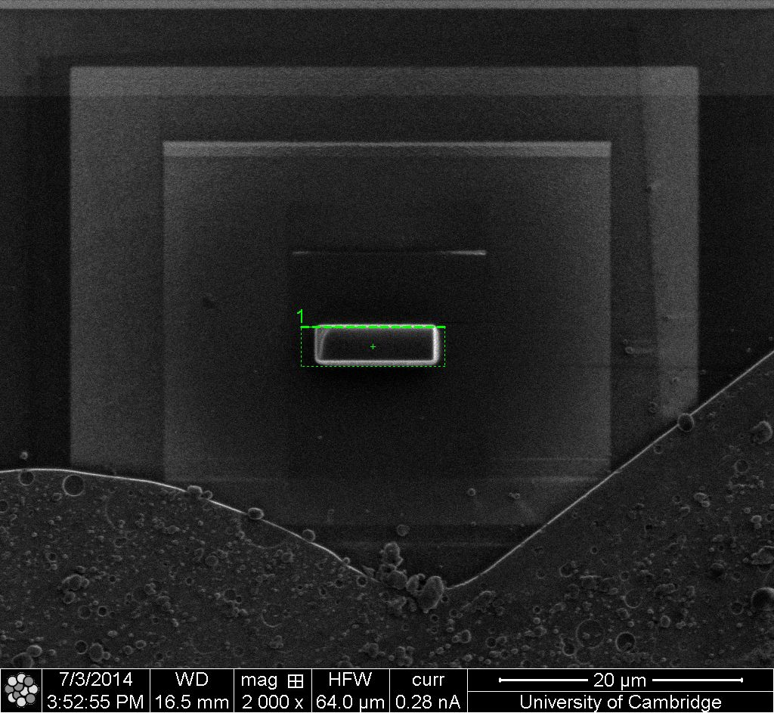
Pt
Specimen
Pt
Trench
Specimen
Probe

